Slide 1
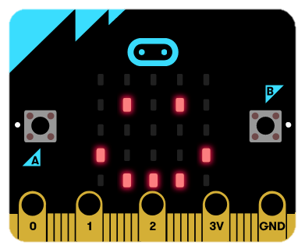
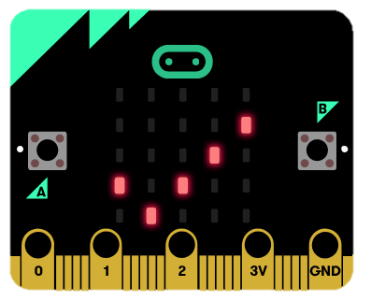
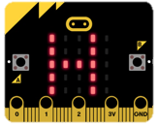
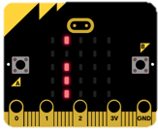
Display Cards
Display Cards
Say Hello
Add Your Name
Display Image
Create an Emoji
Tell Time
Make a Wristband
Make a Badge

Slide 2
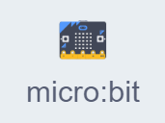
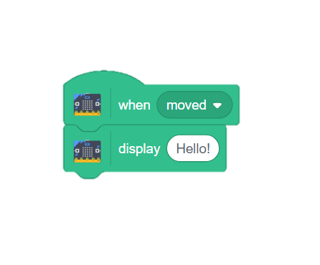
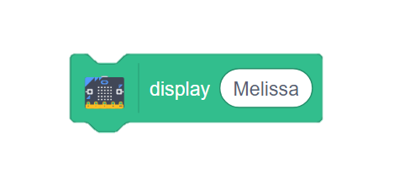
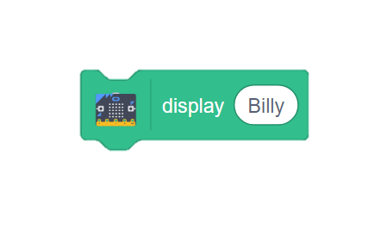
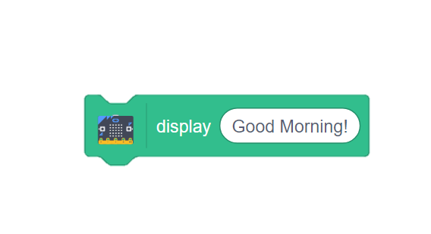
Say Hello
Say Hello
GET READY
Make your micro:bit display a greeting.
Connect your micro:bit to Scratch.
ADD THIS CODE
TRY IT
Move your micro:bit. Can you read the message?
CHALLENGE: What else can you make the
display say?
1

Slide 3
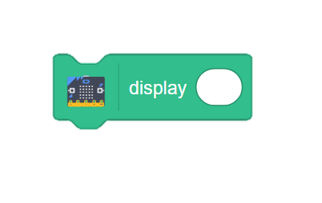
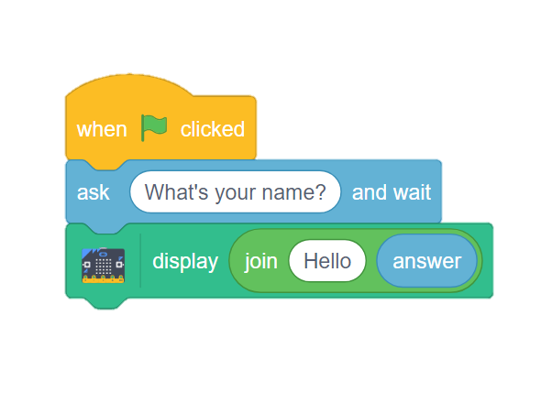
Add Your Name
Add Your Name
GET READY
Program the micro:bit to display your name.
Use the Sensing blocks to interact with your micro:bit.
ADD THIS CODE
Combine your answer into a phrase.
ANNA
TRY IT
Start the program and type your name. What happens on your micro:bit?
2

Slide 4
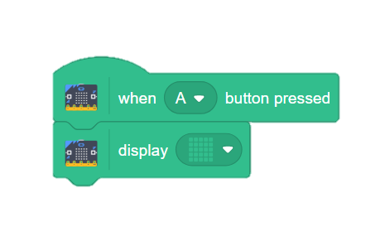
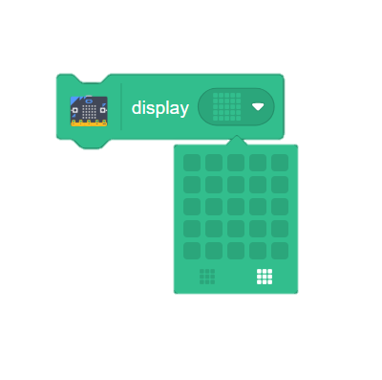
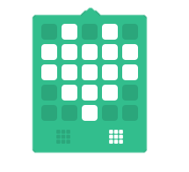
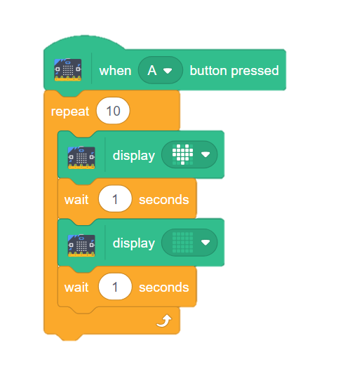
Display Image
Display Image
ADD THIS CODE
Depict an image on your display.
MAKE A DESIGN
Use the 5x5 grid to create your design.
Turn on/off each light by clicking on the desired blocks.
TRY IT
Click the A button to display the image on your micro:bit.
CHALLENGE: Can you make the lights in your image blink on and off repeatedly?
3

Slide 5
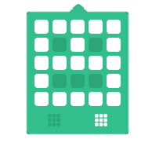
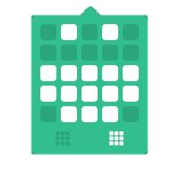
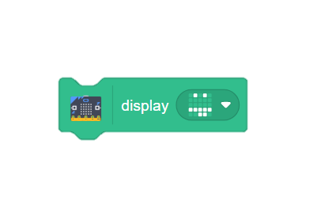
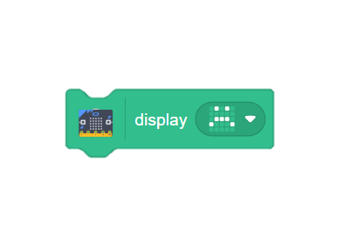
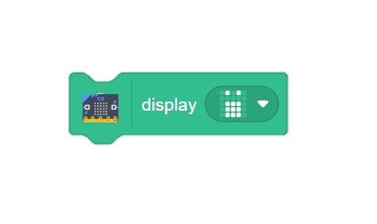
Create an Emoji
Create an Emoji
ADD THIS CODE
Create your own emoji for the display.
MAKE A DESIGN
Click the individual blocks to turn them on in your design.
Click to turn all lights off/on.
TRY IT
Click the A button to display the image on your micro:bit.
CHALLENGE: What other emojis can you create?
4

Slide 6
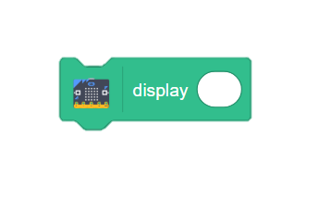
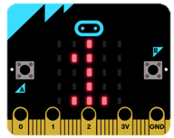
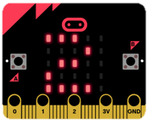
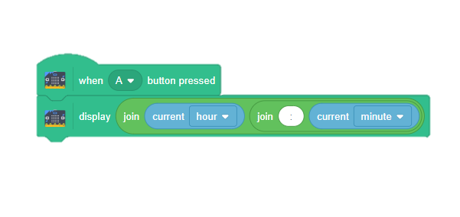
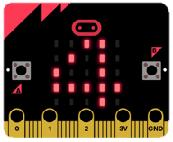
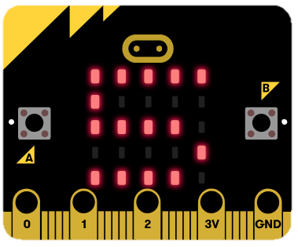
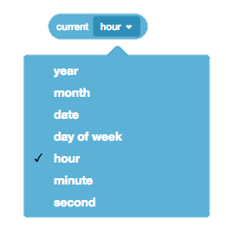
Tell Time
Tell Time
GET READY
Display the correct time on your micro:bit.
Use the Sensing blocks to interact with your micro:bit.
ADD THIS CODE
Join the current hour and minute together using these Operator blocks.
TRY IT
Click the A button to display the time on your micro:bit.
CHALLENGE: What other information can you make your micro:bit display?
5

Slide 7
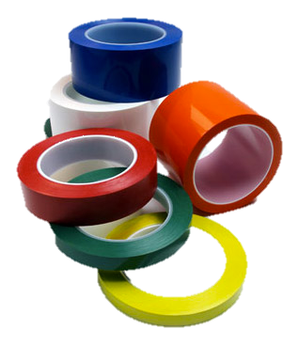
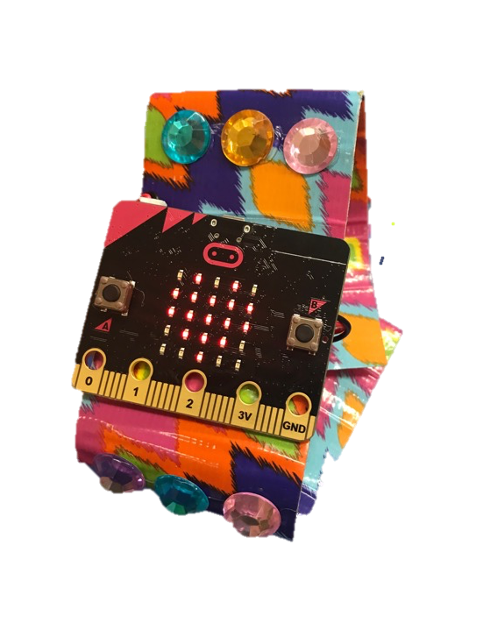
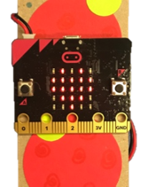
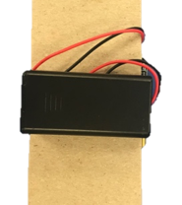
Make a Wristband
Make a Wristband
MATERIALS
Wear your micro:bit on your wrist!
Heavy paper
or
Duct tape
(2in)
Scissors
Hot glue or Glue Dots
Craft
materials
Velcro
PROCEDURE
Use heavy paper or folded Duct tape to create the wristband.
Decorate with craft materials.
2 in.
9 in.
Front
Back
Adhere Velcro fasteners.
TRY IT
Use a small amount of hot glue or a Glue Dot to secure your micro:bit to the front of the wristband.
Attach the battery pack to the back.
***Hot glue placed on the back of the micro:bit (avoiding the pins) will not cause harm.
Based on project from Microsoft workshop
6

Slide 8
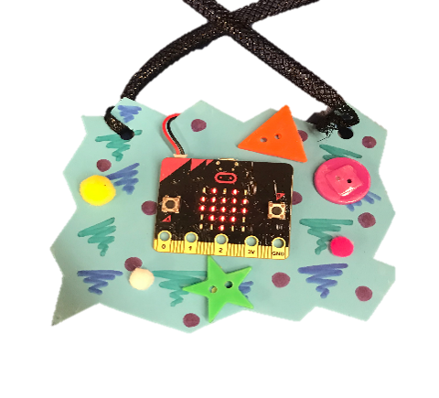
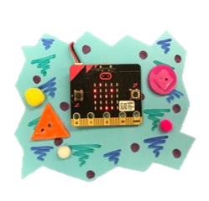
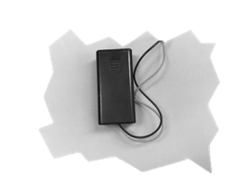
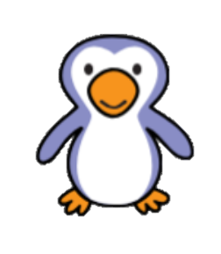
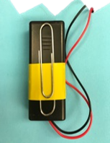
Make a Badge
Make a Badge
MATERIALS
Wear your micro:bit on your shirt!
Craft foam
Scissors
Hot glue or Glue Dots
Craft
materials
String
Paper clip
PROCEDURE
BACK
Use foam to design the shape of your badge. Decorate with craft supplies.
Attach your micro:bit with hot glue to the front of the badge. Connect the battery pack to the back.
TRY IT
Add a paperclip to the back of the battery pack to clip the badge onto your shirt!
To wear your badge as a necklace, poke a hole at each of the top corners and attach a string.
***Hot glue placed on the back of the micro:bit (avoiding the pins) will not cause harm.
7

