Slide 1
Pen Cards
Pen Cards
Back and Forth
Draw a Line
Special Effects
Random Drawing
Voting Machine
Stamp and Record

Slide 2
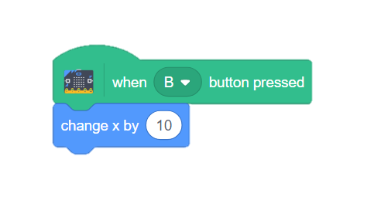
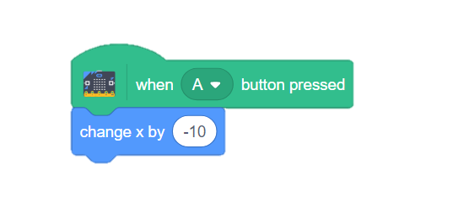
Back and Forth
Back and Forth
GET READY
Use the A and B buttons to move your sprite.
Add a sprite and a background.
ADD THIS CODE
TRY IT
Press the A and B buttons to move your sprite.
CHALLENGE: Can you make your sprite move up and down instead of left and right?
1

Slide 3
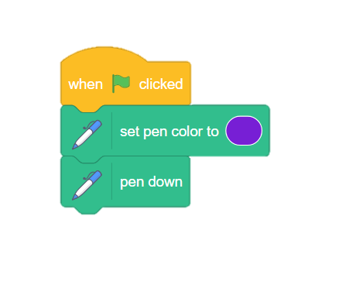
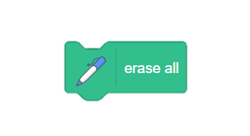
Draw a Line
Draw a Line
GET READY
Draw a line with your sprite as it moves.
Connect the Pen extension.
ADD THIS CODE
Make your pen show up on the screen.
TRY IT
Press the A and B buttons to move your sprite. Does it draw a line?
CHALLENGE: Can you add a RESET block to erase the line?
2

Slide 4
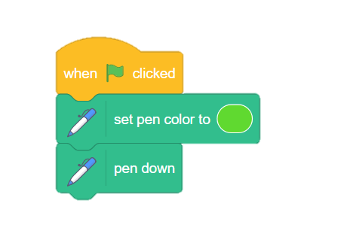
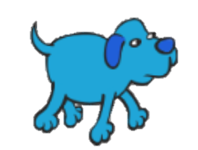
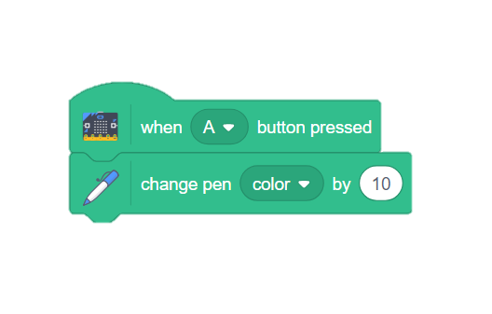
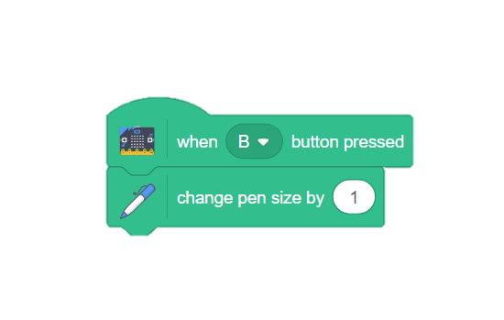
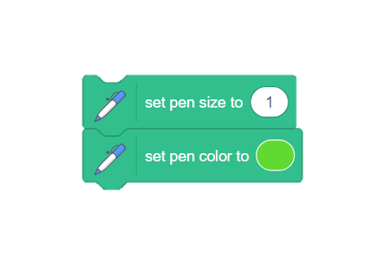
Special Effects
Special Effects
GET READY
Change the color and size of your pen.
Activate the pen.
ADD THIS CODE
TRY IT
Press the A and B buttons to change the pen.
CHALLENGE: Can you add code to make the pen go back to its original settings?
3

Slide 5
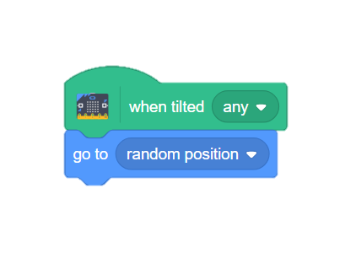
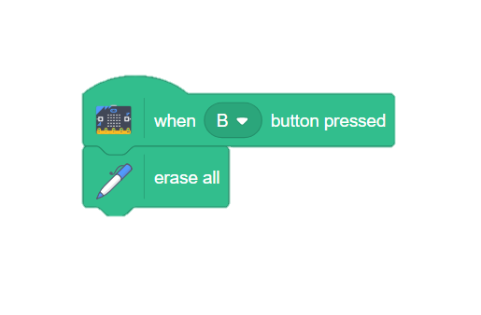
Random Drawing
Random Drawing
GET READY
Make your sprite draw as it moves randomly around the stage.
Activate the pen.
ADD THIS CODE
Let Scratch decide where the sprite will move.
TRY IT
Put it all together. Add the A and B buttons to change the effects.
Can you make your sprite draw?
4

Slide 6
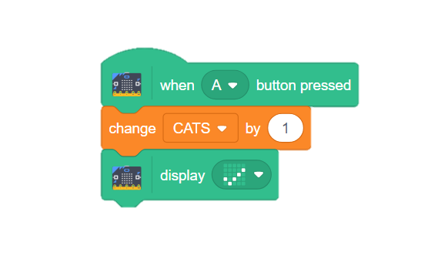
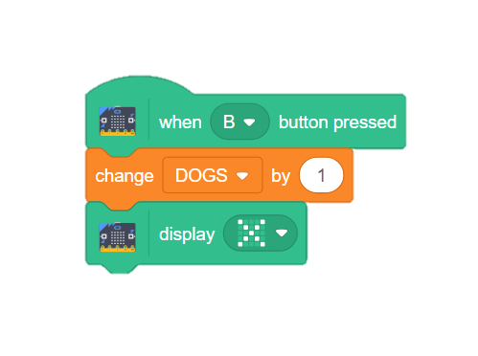
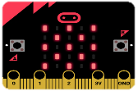
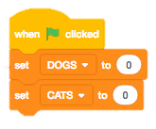
Voting Machine
Voting Machine
GET READY
Use your micro:bit to count responses.
Choose in the Blocks Palette.
Make 2 variables and check the boxes to make them appear on the screen.
ADD THIS CODE
Variables will increase with each button press.
TRY IT
A
B
Change the variables by clicking the A button or B button. What do you notice on your micro:bit?
CHALLENGE: Can you add a RESET script to change the numbers back to zero?
5

Slide 7
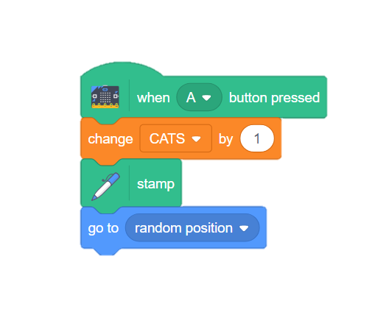
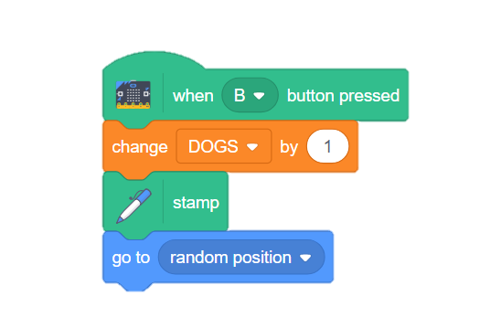
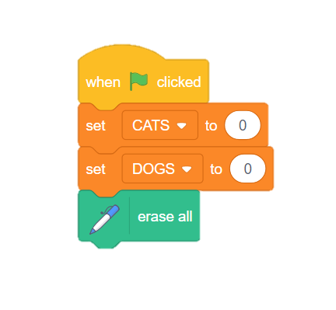
Stamp and Record
Stamp and Record
GET READY
Use the stamp function to add sprites as the voting machine advances.
Choose in the Blocks Palette.
Make 2 variables and check the boxes to make them appear on the screen.
ADD THIS CODE
TRY IT
Add a RESET code and then try it out! Do stamped sprites appear?
6

