Slide 1
EFB VS AFB

Slide 2
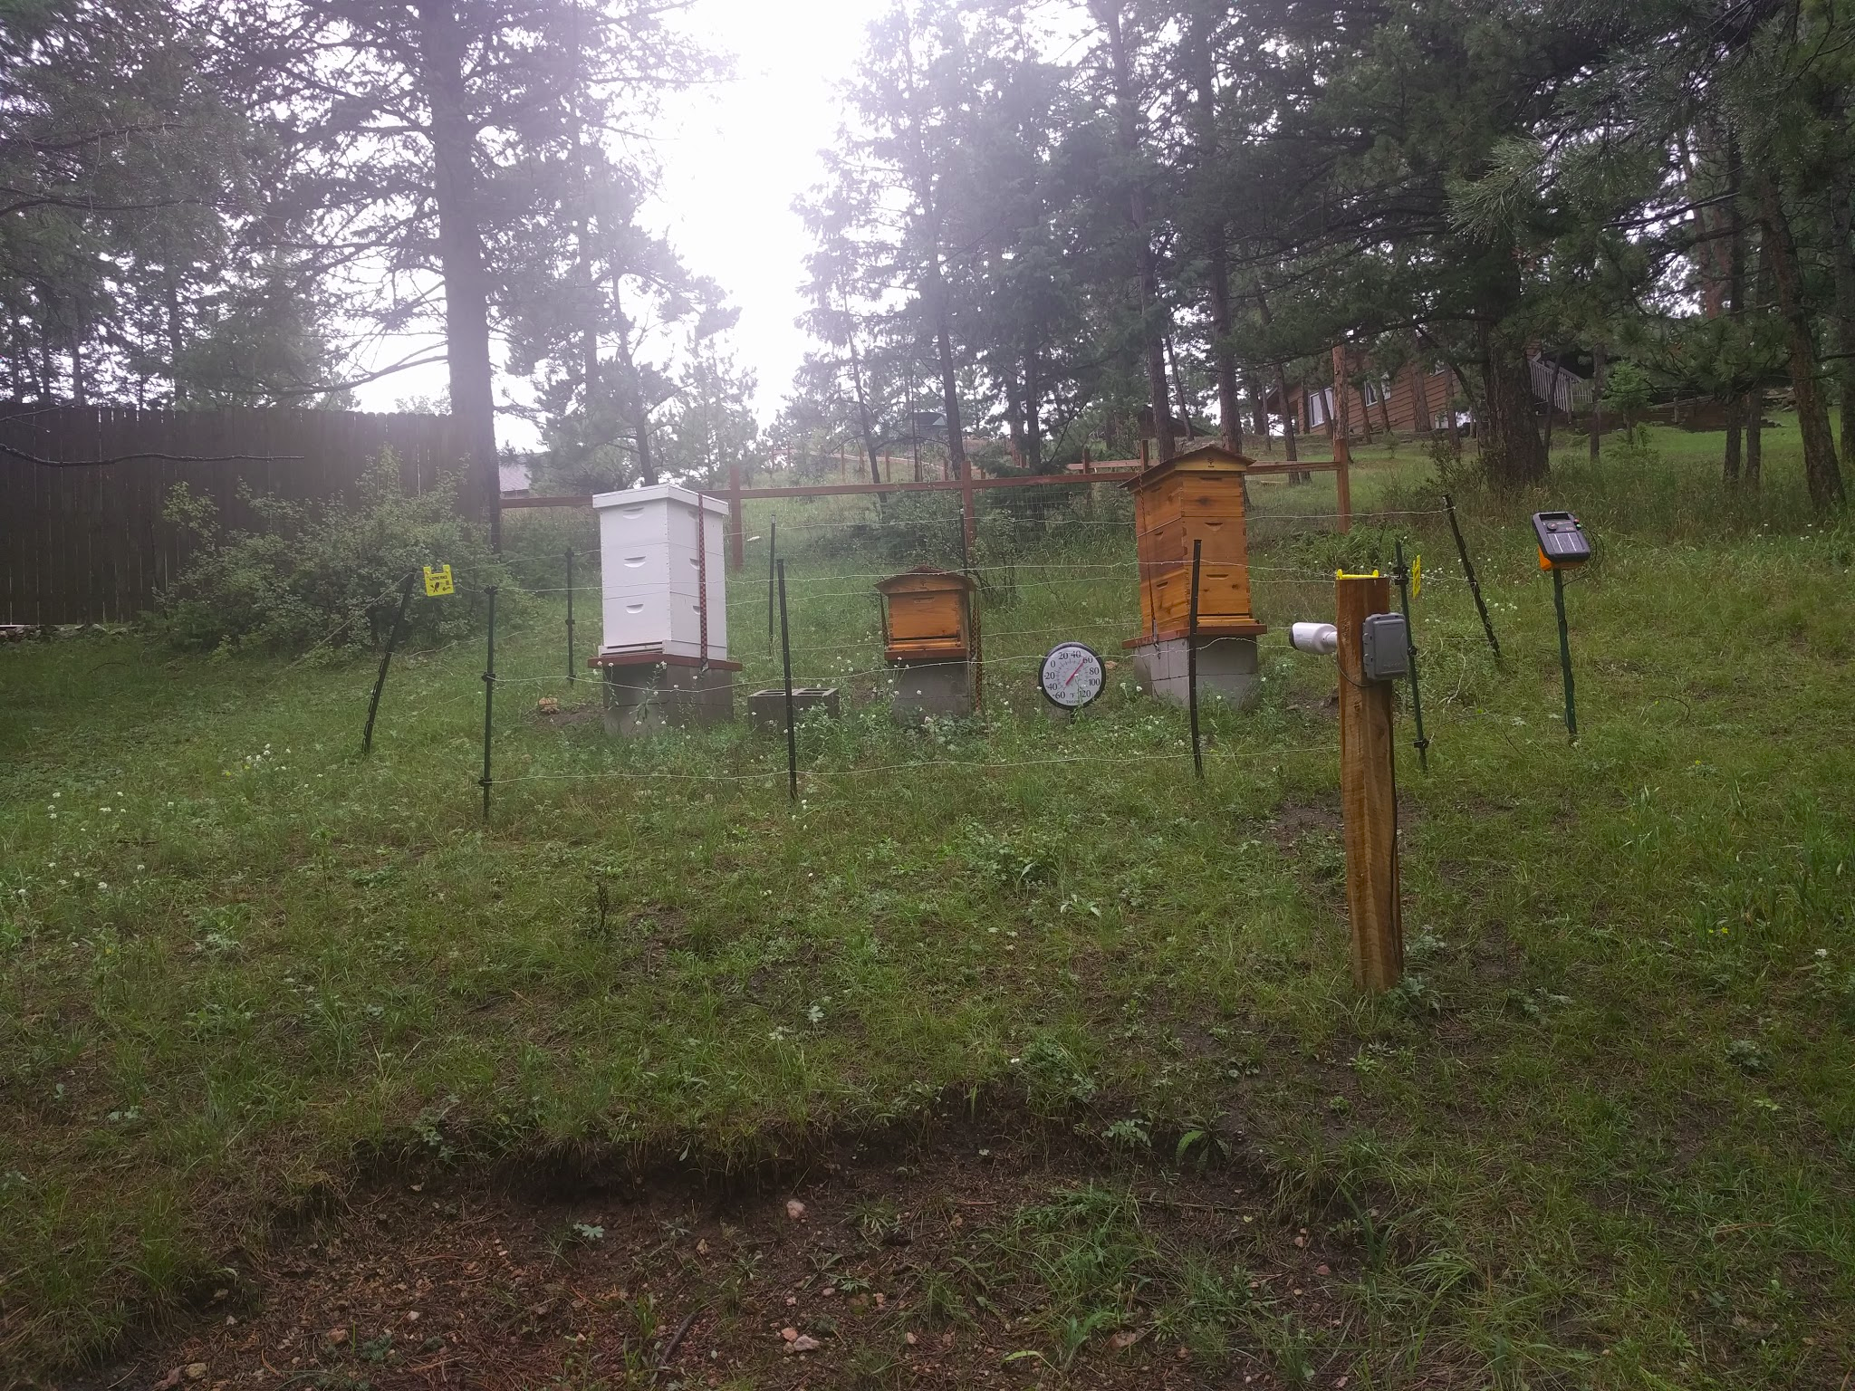
Introduction
Cathy Medbury DVM
Oregon State University 2011
Small Animal + Bees
First Hive 2016
2017 three hives in Evergreen, CO

Slide 3
European Foulbrood
Melissococcus plutonius
Most common in the spring when brood rearing is at its height, though usually the earliest reared brood is not affected. Sometimes the disease appears suddenly and spreads rapidly within infected colonies; at other times it spreads slowly and does little damage. As a rule, it subsides by mid- summer, but occasionally it continues to be active during summer and fall or may reappear in the fall. A good honey flow seems to hasten recovery.

Slide 4
American Foulbrood
Paenibacillus larvae
One of the most widespread and the most destructive of the honey bee brood diseases. At first, the population of an infected colony is not noticeably decreased and only a few dead larvae or pupae may be present. The disease may not develop to the critical stage where it seriously weakens the colony until the following year, or it may advance rapidly and seriously weaken or kill the colony the first season.

Slide 5
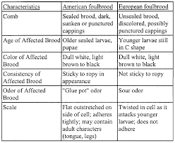
AFB vs EFB

Slide 6
Signs and symptoms
EFB
Spotty brood pattern, whitish-yellow to brown larvae, curled upward or twisted.
• Odors produced can be sour or fish-like, or no odor at all (different odors can come from secondary bacteria.) Scale is usually from brown to black sunken to the bottom of the cell.
• Deflated larvae in the bottom of the cell with a defined tracheal system (usually greyish to brown in color with white trachea.)
• Outside frames of the brood nest are usually infected first.
• Sometimes ropes stretching up to 1.5 cm.
AFB
Spotty brood pattern, perforated sealed brood with coffee brown larvae inside, sunken sealed brood, coffee brown larvae sunken to the bottom of the cell.
• Moisture on sunken sealed brood, protruding pupal tongue (rare), and rotting smell (compared to rotting meat or sulfurous chicken house).
• Light to dark brown to black scale that is hard to remove.
• Often colonies next to infected colonies will show symptoms of the disease.
• Larvae rope at least 2 cm.

Slide 7
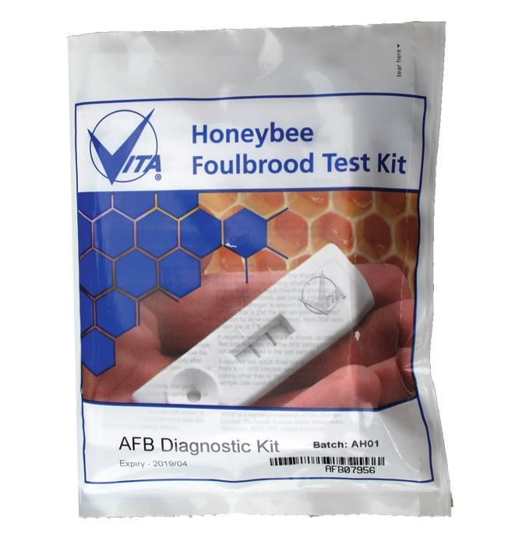
Diagnostics
At home test sticks - any color equals positive
Send in samples to USDA for testing
http://www.ars.usda.gov/Services/docs.htm?docid=2882

Slide 8
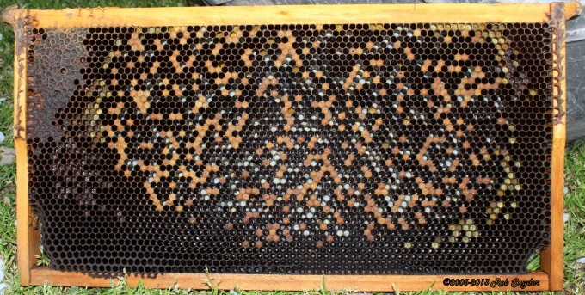
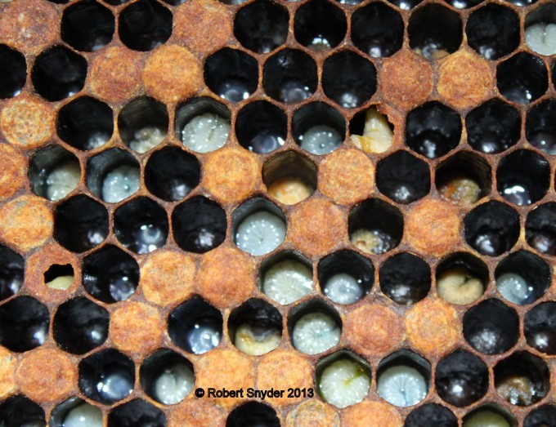
EFB Frame

Slide 9
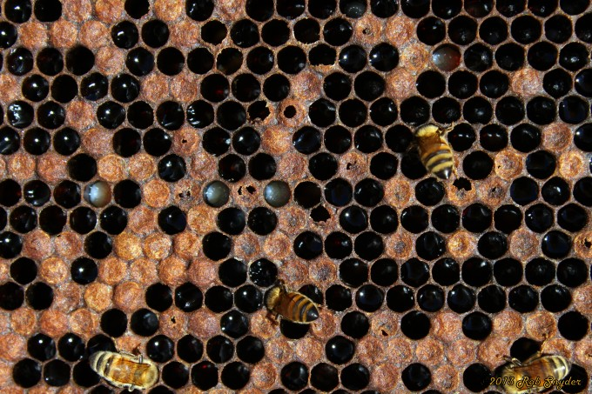
AFB Frame

Slide 10
How did this happen?
EFB Transmission
The organism becomes mixed with the brood food fed to the young larva by the nurse bees, multiplies rapidly within the gut of the larva, and causes death within 4 days after egg hatch. House bees cleaning out the dead larvae from the cells distribute the organism throughout the hive. Since the honey of infected colonies and the beekeeper's equipment are undoubtedly contaminated, subsequent spread of the disease is accomplished by robber bees, exposure of contaminated honey by the beekeeper, interchange of contaminated equipment among colonies, and perhaps, to some extent, by drifting bees.
AFB Transmission
The spores are fed to young larvae by the nurse bees. They then germinate in the gut of the larva and multiply rapidly, causing the larva to die soon after it has been sealed in its cell. By the time of death of the larva, the new spores have formed. When the house bees clean out the cell containing the dead larva, these spores are distributed throughout the hive and more and more larvae become infected. The honey in an infected colony can become contaminated with spores and can be a source of infection for any bee that gains access to it. For example, as a colony becomes weak, it cannot defend itself from attacks by robber bees from strong nearby colonies; these robbers take back the contaminated honey to their own colony, continuing the cycle of infection. The beekeeper also may inadvertently spread the disease by exposing contaminated honey to other bees or by the interchange of infected equipment. Moreover, drifting bees or swarms issuing from an infected colony may spread the disease.

Slide 11
Treatment
EFB
The only product labeled for control of EFB is Terramycin (Oxytetracycline hydrochloride). If the colony is infected it is important to treat 3 times with Terramycin 5 to 7 days apart.
Re-queening with a hygenic or high producing queen is also a treatment option.
Shook swarm method with supplemental feeding has been shown to be effective in some cases.
Honey super must be removed when treating with Terramycin.
AFB
Can not be cured! It is best to burn all colonies infected with AFB but you can manage infected colonies with antibiotics.
There are two antibiotics used for management AFB: Terramycin and Tylan. If AFB is not resistant to Terramycin (oxytetracycline hydrochloride) then this antibiotic is used. If the strain of AFB is resistant to Terramycin, than Tylosine is the antibiotic used to treat the colony.
Treating colonies 2 weeks prior to the nectar flow is recommended to prevent honey from being contaminated.

Slide 12
Why do bees need a veterinarian?
FDA 2017 Veterinary feed directive rule.
Antibiotics should not be used for growth promotion or feed efficiency
Only therapeutic uses (no prophylactic use)
Prevention of antibiotic resistant bacteria
More than just a writer of prescriptions

Slide 13
Questions?

