Slide 1

Lag Time
Blood and ISF

Slide 2
Kinetic equilibrium governs the relation between blood and ISF
However,,
This equilibrium can be perturbed by:
Physiological factors such as:
1-Foreig body response
2-Wound healing process (which consume glucose and release coagulation factors )

Slide 3
Even there is much debate of the accuracy of CGM compared to SBGM, the main competitive advantage of CGM:
1-providing current absolute values
2- trends of glucose concentration.
This enhances the capability:
1- to detect rapid hypo- and hyperglycemia events
2- allows the possibility of evaluating glycemic variability parameters(like MAGE ,j index and glucose excursion indices ), which are promising markers for the prevention of diabetic complications

Slide 4
3-decrease the occurrence of hypo/hyperglycemia events
4-lower glycemic variability
5-improve metabolic control (HbA1c)

Slide 5

Hint…………..
if, CGM data are used (and calibrated) retrospectively,,, ,,,,,,,,,,,,,,
this raises concerns about the impact of a significant physiological lag time( esp. in critically ill patients ) on the capability of CGMs to support in RT in the person with diabetes
Notes:
RT: real time ,remember this slide very well……………………

Slide 6
Two factor s lead to diff. between blood and ISF:
1 - Magnitude gradient
2- Time gradient

Slide 7
1-Magnitude gradient:
the difference in absolute glucose concentration between plasma and IF. In :
1- glucose concentration value in the two compartments during the steady-states
2- magnitude of the respective glucose
concentration excursions

Slide 8
Studies reported conflicting results about this topic.:
1-Glucose excursions and their values in their respective steady-states were found to be similar.
2-a large group of studies agrees that both the glycemic excursions and steady-state values of IFG and BG can show significant difference in the glucose excursion magnitude at high glycemic values during rapid rises of BG, following to falling phases of BG.
Tip…..
Glucose concentration in the interstitial fluid throughout steady-states was
lower than that of plasma for prolonged periods of time in people with
Diabetes (push-pull model)

Slide 9
2-Time gradient
With the time gradient : it is intended the delay, or lag time, observed between the variation of the BG value (the corresponding change in IFG.
The term ‘lag time’ usually refers only:
to the physiological lag time
However; there is also instrumental lag, which includes:
1-device used for the IFG sampling and measurement.
2- The time needed for glucose to be transported from IF to the biosensor
3- computational lag, related to all the calculation algorithms applied.

Slide 10
* In the large majority of studies it was:
observed that the IFG delayed with respect to the BG, independently
of whether the BG is rising, falling or reaching nadirs/peaks, confirming a kinetic equilibrium based on a ‘two-compartment’ model of glucose.
In other studies the IFG was found to anticipate the BG decrease during insulin-induced hypoglycemia. This was explained by increased glucose uptake from the IF by the surrounding cells(push-pull model)

Slide 11
As the relation between ISF and blood is vague and non-precisely determined; two models were proposed in order to clarify-at least mathematically-this complicated situation :

Slide 12
The first one is :
Two compartments model
Second one is :
Push-pull model

Slide 13
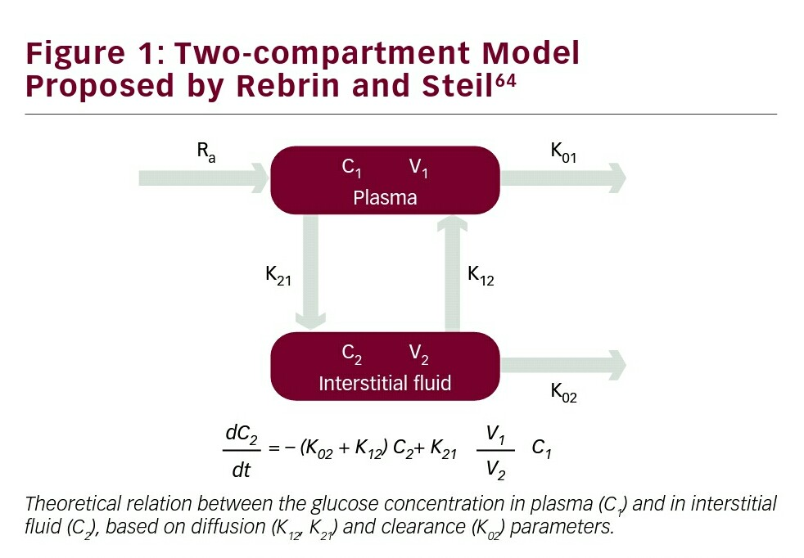
Notes:
This model proposed by (rebrin and steil ) in order to clarify the relation between blood and ISF based on the assumption that glucose is –freely- diffuses from blood to ISF while it is taken by the surrounding tissue

Slide 14
Two compartment model
Rebrin and Steil proposed a ‘two-compartments’ model, which described
IF and blood as two independent compartments (or pools), separated by
a diffusional barrier through which the glucose is free to diffuse based
on its concentration gradient. Moreover, the glucose is
cleared from the IF by the surrounding cells, depending from IFG. This
model provides an effective mathematical description of two important
phenomena experimentally observed in several studies: the IFG
follows the BG with a certain lag time; during the steady-states the glucose
concentration in the two compartments can be significantly different.
The only concern about this model is the assumption that both the diffusion
across the IF/blood barrier and the clearance from the IF are related to
BG and IFG values by constants (K12, K21 and K02 in the equation of Figure 1),
while several evidences suggest that the dependence of these diffusion
processes by BG and IFG is variable over the time.

Slide 15
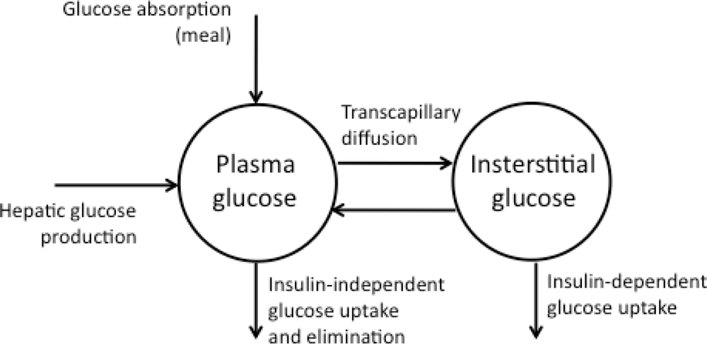
Push-pull model
Notes:
Glucose drops earlier in IST fluid (at the presence of insulin ) due to the (pull) effect of the surrounding tissues which continuously withdraw glucose

Slide 16
Push-Pull effect
Another widely recognized model, based on the ‘push–pull’ effect, was proposed by Aussedat et al.91 This approach hypothesized that during
the rising of BG the lag time between BG and IF is caused by the glucose diffusion (push) from blood to IF, while during the falling period of BG the
IFG decreases in advance with respect of BG, due to the insulin-induced uptake (pull) of glucose by the surrounding cells. This model allows explanation how in some particular conditions (e.g. insulin-induced hypoglycemia) the drop of IFG can anticipate that of blood

Slide 17
Physiological Conditions Affecting BG and SG Correlation

Slide 18
The kinetic equilibrium between BG and IFG, which allows an explanation of both the time and magnitude gradients, can be perturbed by the characteristics of the subcutaneous tissue, which represents a nonstandard matrix in continuous change, depending on the physiological conditions of the subject.
Considering the case of minimally invasive CGMs, the insertion of a probe/sensor in the subcutaneous tissue causes a trauma at the implantation site, because of the disruption of the tissue structure, thus leading to a FBR.,several local tissue reactions are likely to occur at the implantation site:
Notes:
FBR : foreign body response

Slide 19
• Biofouling: a specific protein adsorption on the foreign body surface
(collagen and other proteins are secreted into the IF space due
to transforming grow factor b1 and connective tissue growth
factor), with a consequent obstruction to the glucose diffusion
across the IF–probe interface.
• Wound-healing effect: the wound-healing cascade can increase
the vascularization around the implanted probe, modifying the
inter-compartment glucose equilibrium between plasma and
IF The formation of well- vascularized granulation tissue near
to the implantation site is likely to enhance glucose diffusion
at the sensor–tissue interface-compared with avascular
fibrous encapsulation.
• Localized accumulation of inflammatory cells, macrophages,
monocytes, mast cells and the release of cytokines and
chemokines; can lead to increased oxygen and glucose
consumption near to the implantation site.

Slide 20
• Fibrous encapsulation at sensor–tissue interface can alter the diffusional equilibrium.
• Proteolytic enzymes and free radicals*, and local drops of pH due to foreign body digestion attempts, can damage to the sensor/probe surface.
• Cycles of bleeding and coagulation at the implantation site can interfere with the sensor–probe functionality
Notes:
* Results from redox rxn which yield electrons in order for glucose to be measured ,ultimately

Slide 21

Generally the main effect of these local reactions is transitory and limited
to the few hours after the probe implantation, until a new physiological
equilibrium at the tissue/probe interface is reached. However, the
occurrence of:
pressures
collisions
mechanical shocks
Which can :
reactivate the local reactions and thus alter the
equilibrium at the sensor–tissue interface, leading to another transitory
period of lowered IFG versus BG correlation or,
failure of the CGM sensor or,
Signal drift (main requirement o recalibration)

Slide 22
edema
shock
hypotension
drug administration
altered blood perfusion inthe sensor area
thermoregulation
physical exercise.

Slide 23
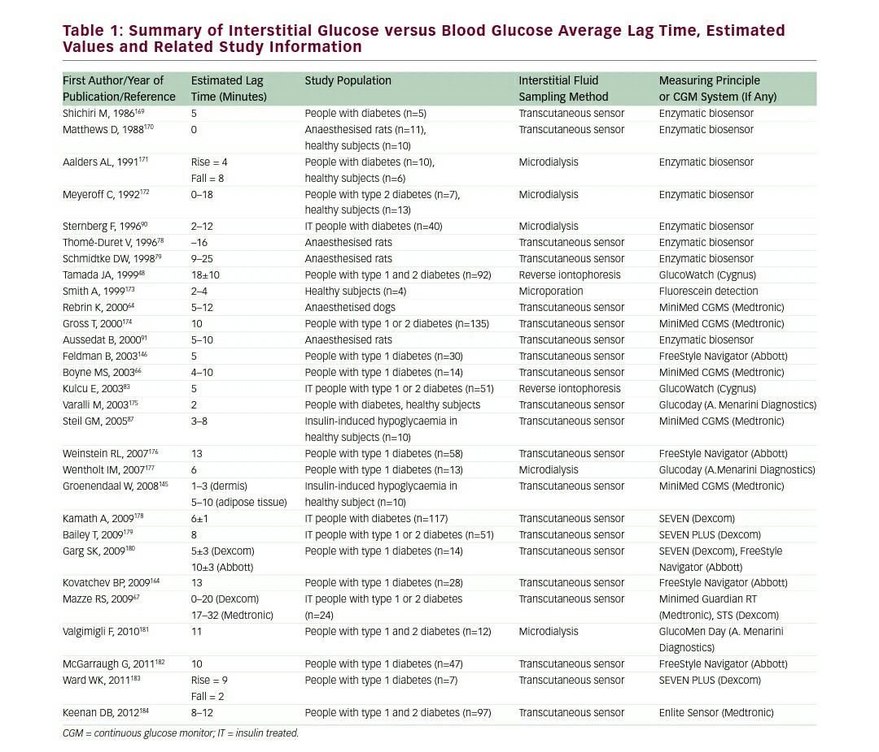

Slide 24
Referring to studies results reported in Table 1, such a high variability of
outcomes indicates that both time and magnitude gradients are extremely
case dependent,
and that their presence/absence, variability and absolute
values are related to the specific experimental conditions in which each
study was performed:
IF sampling method used (microdialysis, transdermal,
iontophoresis, etc.);
IF sampling site (epidermis, dermis, adipose tissue);
IFG measuring method (CGMs or SLB);
tested population (animals/humans);
healthy or type 1/type 2 people with diabetes);

Slide 25
glycemic control protocol
(oral glucose tolerance test [OGGT],
insulin/glucose clamp, insulin-induced
hypoglycemia, etc.);
appropriate subtraction of the instrumental time lag(of the CGM device or of the sampling/measurement method used);
Effect of noise reduction and other compensation/elaboration algorithms,

Slide 26
IFG measurement entails a significant impact/effects on the accuracy of these systems.:
pre-analysis effects, affecting the system prior of data collection (such as on calibration whether personal or done in the factory);
intra-analysis effects, occurring during the measuring phase (such as sample selection ….;
post-analysis effects, related to the CGMs accuracy evaluation

Slide 27
pre-analysis effects (calibration)
The calibration of a system that operates in a certain matrix, the IF, using measurement values collected in another matrix (venous/capillary blood) means that those differences existing between these matrixes will reduce the calibration quality, and thus the accuracy of the system.

Slide 28
Calibration by blood measurements need to be performed during euglycemic status ,otherwise ,significant errors/difference may result
Up to 20 %

Slide 29
In order to overcome the BG versus IFG magnitude gradient, several /two point calibration methods have been developed. These methods are based on the use of two independent BG calibration points, collected in distinct moments and required to be significantly different in the absolute glucose value (>30 mg/dl)
Unfortunately, those calibration methods are less effective and more error prone when applied in RT.
Notes:
RT :real time

Slide 30
However,,
lag time can be mitigated in the retrospective calibration of the CGMs, where the availability of several BG references can allow the calibration versus both the time and magnitude gradient between BG and IFG to be optimized, by means of:
an algorithm-driven calibration points selection
or,
and two-point or linear regression

Slide 31
Example . By king at al
retrospective recalibration of the RT-calibrated CGM data allowed a relevant reduction of the mean absolute deviation during the steady euglycaemic state (from 20.9 down to 10.6 mg/dl).
Another example by by Facchinetti et al
the mean absolute percentage error was reduced from 10.4 to 6.9 %.

Slide 32

RT-CGM calibration
represents a real challenge due to: calibration –wise selection is not easily pointed and thus not significantly mitigated *
Notes:
* SC tissue, kinetic equilibrium and continuous glucose absorption make its difficult to fix a constant relationship between blood and ISF

Slide 33
Intra-analysis effects
As the delay is variable ,this problem can be mitigated by using:
1- retrospective data ,however this will not be applicable in RT due the fact that glucose in ISF will follow the blood value by a lag ( physiological + instrumental ) 10-20 min

Slide 34
2- the development of more and more biocompatible and miniaturized sensors in order to minimize the FBR and therefore the possibility of having local reactions after implantation.

Slide 35
3- redundant sensing, which is based on the use of multiple sensors, and in the combination of all the CGM signals collected in parallel. The aim of this method is to detect individual aberrant (outlier) sensor values by means of the responses of the other sensors. The redundant sensing can also be
‘orthogonal’, that is, using sensors with different measuring principles and thus are subjected to different interferences.

Slide 36

Despite the current developments regarding biocompatibility ,miniaturization and redundant sensing, the CGM errors related to the loss of correlation between IF and blood cannot be avoided either in the retrospective or in the RT CGM application, and can be detected only by the direct comparison with frequent BG reference measurements.*
Notes:
*Intra analysis effects are the hardly investigated/minimized by ABBOTT in order to develop FSL

Slide 37
Post-analysis effects
(CGM accuracy assessment)
Two methods :

Slide 38
I-Kovatchev’s Poincarè
Plot’
1- taking lag time into consideration while compared with BG values :
The suggested method : consists of the calculation of Pearson’s correlation coefficient R between CGM and BG reference data pairs, by applying increasing delays to the CGM signal. The applied delay corresponding to the highest R value is considered as the average lag time. The correction is then applied by shifting back in time the CGM data subtracting a delay equal to the calculated average lag time.

Slide 39
II-Glucose Error Grid Analysis (CG-EGA)
2-Another valuable improvement to CGMs’ accuracy assessment was particular case of CGMs. The CG-EGA applies different point-accuracy acceptance criteria dependently from the rate of change of BG, and thus allows progressively higher tolerances in case of rapid glucose excursions. *
Notes:
* Glucose excursion is taken into consideration

Slide 40
References :
1. Benhamou PY, Catargi B, Delenne B, et al., Real-time
continuous glucose monitoring (CGM) integrated into the
treatment of type 1 diabetes: Consensus of experts from
SFD, EVADIAC and SFE, Diabetes Metab, 2012;38:S67–83.
2. Hovorka R, Nodale M, Haidar A, Wilinska ME, Assessing
performance of closed-loop insulin delivery systems by
continuous glucose monitoring: drawbacks and way forward,
Diabetes Technol Ther, 2013;15:4–12.
3. Klonoff DC, The artificial pancreas: how sweet engineering will
solve bitter problems, J Diabetes Sci Technol, 2007;1:72–81.
4. Van den Berghe G, Wouters F, Verwaest C, et al., Intensive
insulin therapy in critically ill patients, N Engl J Med,
2001;345:1359–67.
5. De Block C, Manuel-y-Keenoy B, Van Gaal L, Rogiers P,
Intensive insulin therapy in the intensive care unit.
Assessment by continuous glucose monitoring, Diabetes
Care, 2006;29:1750–6.
6. Holzinger U, Warszawska J, Kitzberger R, et al., Real-time
continuous glucose monitoring in critically ill patients,
Diabetes Care, 2010;33:467–72.
7. Siegelaar SE, Holleman F, Hoekstra JBL, DeVries JH, Glucose
variability; does it matter?, Endocr Rev, 2010;31:171–82.
8. Penckofer S, Quinn L, Byrn M, et al., Does glycemic variability
impact mood and quality of life?, Diabetes Technol Ther,
2012;14:303–10.
9. Klonoff DC, Technology to treat hyperglycemia in trauma,
J Diabetes Sci Technol, 2007;1:151–2.
10. Damiano RE, El-Khatib FH, Zheng H, et al., A comparative
effectiveness analysis of three continuous glucose monitors,
Diabetes Care, 2013;36:251–9.
11. Ligtenberg JJM, de Plaa ME, Zijlstra JG, Continuous
subcutaneous glucose monitoring: good enough to use in
glucose regulation protocols?, Critic Care, 2011;15:403.
12. Battelino T, Conget I, Olsen B, et al., The use and efficacy of
continuous glucose monitoring in type 1 diabetes treated
with insulin pump therapy: a randomised controlled trial,
Diabetologia, 2012;55:3155–62.
13. Rubin RR, Peyrot M, STAR 3 Study Group, health-related
quality of life and treatment satisfaction in the sensoraugmented
pump therapy for A1C Reduction 3 (STAR 3) trial,
Diabetes Technol Ther, 2012;14:143–51.

Slide 41
14. O’Connell MA, Donath S, O’Neal DN, et al., Glycaemic impact
of patient-led use of sensor-guided pump therapy in type
1 diabetes: a randomised controlled trial, Diabetologia,
2009;52:1250–7.
15. Raccah D, Sulmont V, Reznik Y, et al., Incremental value of
continuous glucose monitoring when starting pump therapy
in patients with poorly controlled type 1 diabetes: the
RealTrend study, Diabetes Care, 2009;32:2245–50.
16. Hermanides J, Nّrgaard K, Bruttomesso D, et al., Sensoraugmented
pump therapy lowers HbA1c in suboptimally
controlled Type 1 diabetes; a randomized controlled trial,
Diabet Med, 2011;28:1158–67.
17. Bergenstal RM, Tamborlane WV, Ahmann A, et al.,
Effectiveness of sensor-augmented insulin-pump therapy in
type 1 diabetes, N Engl J Med, 2010;363:311–20.
18. Cosson E, Hamo-Tchatchouang E, Dufaitre-Patouraux L,
et al., Multicentre, randomised, controlled study of the
impact of continuous sub-cutaneous glucose monitoring
(GlucoDay®) on glycaemic control in type 1 and type 2
diabetes patients, Diabetes Metab, 2009;35:312–8.
19. Ludvigsson J, Hanas R, Continuous subcutaneous glucose
monitoring improved metabolic control in pediatric
patients with type 1 diabetes: a controlled crossover study,
Pediatrics, 2003;111:933–8.
20. Tanenberg R, Bode B, Lane W, et al., Use of the continuous
glucose monitoring system to guide therapy in patients with
insulin-treated diabetes: a randomized controlled trial, Mayo
Clin Proc, 2004;79:1521–6.

Slide 42
31. Garg SK, Schwartz S, Edelman SV, Improved glucose
excursions using an implantable real-time continuous
glucose monitoring sensor in adults with type 1 diabetes,
Diabetes Care, 2004;27:734–8.
32. Chase HP, Roberts MD, Wightman C, et al., Use of
GlucoWatch Biographer in children with type 1 diabetes,
Pediatrics, 2003;111:933–8.
33. Juvenile Diabetes Research Foundation Continuous Glucose
Monitoring Study Group, Tamborlane WV, Beck RW, Bode BW,
et al., Continuous glucose monitoring and intensive treatment
of type 1 diabetes, N Engl J Med, 2008;359:1464–76.
34. Liebl A, Henrichs HR, Heinemann L, et al., Continuous glucose
monitoring working group of the working group diabetes
technology of the German Diabetes Association, continuous
glucose monitoring: evidence and consensus statement for
clinical use, J Diabetes Sci Technol, 2013;7:500–19.
35. Diabetes Research in Children Network (DirecNet) Study
Group, Youth and parent satisfaction with clinical use of the
GlucoWatch G2 Biographer in the management of pediatric
type 1 diabetes, Diabetes Care, 2005;28:1929–35.
36. Juvenile Diabetes Research Foundation Continuous
Glucose Monitoring Study Group, Validation of measures of
satisfaction with and impact of continuous and conventional
glucose monitoring, Diabetes Technol Ther, 2010;12:679–84.
37. Rebrin K, Steil GM, Van Antwerp WP, Mastrototaro JJ,
Subcutaneous glucose predicts plasma glucose independent
of insulin. Implications for continuous monitoring, Am J
Physiol, 1999;277:E561–71.
38. Mauras N, Fox L, Englert K, Beck RW, Continuous glucose
monitoring in type 1 diabetes, Endocrine, 2013;43:41–50.
39. Vaddiraju S, Burgess DJ, Tomazos I, et al., Technologies for
continuous glucose monitoring: current problems and future
promises, J Diabetes Sci Technol, 2010;4:1540–62.

Slide 43
40. Heinemann L, Schmelzeisen-Redeker G, Non-invasive
continuous glucose monitoring in type 1 diabetic patients
with optical glucose sensors, Diabetologia, 1998;41:848–54.
41. Pickup JC, Hussain F, Evans ND, et al., Fluorescence-based
glucose sensors, Biosens Bioelectron, 2005;20:2555–65.
42. Pickup J, McCartney L, Rolinski O, Birch D, In vivo glucose
sensing for diabetes management: Progress towards noninvasive
monitoring, Br Med J, 1999;319:1289–93.
43. Heo YJ, Shibata H, Okitsu T, et al., Long-term in vivo glucose
monitoring using fluorescent hydrogel fibers, Proc Natl Acad
Sci U S A, 2011;108:13399–403.
44. Moschou EA, Sharma BV, Deo SK, Daunert S, Fluorescence
glucose detection: advances toward the ideal in vivo
biosensor, J Fluoresc, 2004;14:535–47.
45. Linhares MC, Kissinger PT, Capillary ultrafiltration: in
vivo sampling probes for small molecules, Anal Chem,
1992;64:2831–5.
46. Chuang H, Taylor E, Davison TW, Clinical evaluation of a
continuous minimally invasive glucose flux sensor placed
over ultrasonically permeated skin, Diabetes Technol Ther,
2004;6:21–30.
47. Garg SK, Potts RO, Ackerman NR, et al., Correlation of
fingerstick blood glucose measurements with GlucoWatch
biographer glucose results in young subjects with type 1
diabetes, Diabetes Care, 1999;22:1708–14.
48. Tamada JA, Garg S, Jovanovic L, et al., Noninvasive Glucose
Monitoring: Comprehensive Clinical Results, JAMA,
1999;282:1839–44.
49. Glikfeld P, Hinz RS, Guy RH, Noninvasive sampling of biological
fluids by iontophoresis, Pharm Res, 1989;32:632–41.
50. Potts RO, Tamada JA, Tierney MJ, Glucose monitoring by reverse
iontophoresis, Diabetes Metab Res Rev, 2002;18:S49–53.
51. Rao G, Glikfeld P, Guy RH, Reverse iontophoresis:
development of a noninvasive approach for glucose
monitoring, Pharm Res, 1993;10:1751–5.
52. Tamada J, Bohannon N, Potts R, Measurement of glucose in
diabetic subjects using noninvasive transdermal extraction,
Nat Med, 1995;1:1198–201.
53. Bantle J, Thomas W, Glucose measurement in patients with
diabetes mellitus with dermal interstitial fluid, J Lab Clin Med,
1997;130:436–41.
54. Service FJ, O’Brien PC, Wise SD, et al., Dermal interstitial
glucose as an indicator of ambient glycemia, Diabetes Care,
1997;20:1426–9.
2:2032–9.

Slide 44
21. Bode BW, Gross TM, Thornton KR, Mastrototaro JJ,
Continuous glucose monitoring used to adjust diabetes
therapy improves glycosylated hemoglobin: a pilot study,
Diabetes Res Clin Pract, 1999;46:183–90.
22. Lagarde WH, Barrows FP, Davenport ML, et al., Continuous
subcutaneous glucose monitoring in children with type 1
diabetes mellitus: a single?blind, randomized, controlled
trial, Pediatr Diabetes, 2006;7:159–64.
23. Dalfrà MG, Sartore G, Di Cianni G, et al., Glucose variability in
diabetic pregnancy, Diabetes Technol Ther, 2011;13:853–9.
24. Voormolen DN, DeVries JH, Franx A, et al., Effectiveness of
continuous glucose monitoring during diabetic pregnancy
(GlucoMOMS trial); a randomised controlled trial, BMC
Pregnancy Childbirth, 2012;12:164.
25. Ryan M, Savarese V, Hipszer B, et al., Continuous Glucose
Monitor Shows Potential for Early Hypoglycemia Detection in
Hospitalized Patients, Diabetes Technol Ther, 2009;11:745–7.
26. Deiss D, Bolinder J, Riveline JP, et al., Improved glycemic control
in poorly controlled patients with type 1 diabetes using real-time
continuous glucose monitoring, Diabetes Care, 2006;29:2730–2.
27. Juvenile Diabetes Research Foundation Continuous Glucose
Monitoring Study Group, Beck RW, Hirsch IB, Laffel L, et
al., The Effect of continuous glucose monitoring in wellcontrolled
Type 1 diabetes, Diabetes Care, 2009;32:1378–83.
28. Battelino T, Phillip M, Bratina N, et al., Effect of continuous
glucose monitoring on hypoglycemia in type 1 diabetes,
Diabetes Care, 2011;34:795–800.
29. Battelino T, Conget I, Olsen B, et al., The use and efficacy of
continuous glucose monitoring in type 1 diabetes treated
with insulin pump therapy: a randomised controlled trial,
Diabetologia, 2012;3155–62.
30. Schaepelynck-Belicar P, Vague P, Simonin G, Lassmann-
Vague V, Improved metabolic control in diabetic adolescents
using the Continuous Glucose Monitoring System (CGMS),
Diabetes Metab, 2003;29:608–12.
31. Garg SK, Schwartz S, Edelman SV, Improved glucose
excursions using an implantable real-time continuous
glucose monitoring sensor in adults with type 1 diabetes,
Diabetes Care, 2004;27:734–8.

Slide 45
32. Chase HP, Roberts MD, Wightman C, et al., Use of
GlucoWatch Biographer in children with type 1 diabetes,
Pediatrics, 2003;111:933–8.
33. Juvenile Diabetes Research Foundation Continuous Glucose
Monitoring Study Group, Tamborlane WV, Beck RW, Bode BW,
et al., Continuous glucose monitoring and intensive treatment
of type 1 diabetes, N Engl J Med, 2008;359:1464–76.
34. Liebl A, Henrichs HR, Heinemann L, et al., Continuous glucose
monitoring working group of the working group diabetes
technology of the German Diabetes Association, continuous
glucose monitoring: evidence and consensus statement for
clinical use, J Diabetes Sci Technol, 2013;7:500–19.
35. Diabetes Research in Children Network (DirecNet) Study
Group, Youth and parent satisfaction with clinical use of the
GlucoWatch G2 Biographer in the management of pediatric
type 1 diabetes, Diabetes Care, 2005;28:1929–35.
36. Juvenile Diabetes Research Foundation Continuous
Glucose Monitoring Study Group, Validation of measures of
satisfaction with and impact of continuous and conventional
glucose monitoring, Diabetes Technol Ther, 2010;12:679–84.
37. Rebrin K, Steil GM, Van Antwerp WP, Mastrototaro JJ,
Subcutaneous glucose predicts plasma glucose independent
of insulin. Implications for continuous monitoring, Am J
Physiol, 1999;277:E561–71.
38. Mauras N, Fox L, Englert K, Beck RW, Continuous glucose
monitoring in type 1 diabetes, Endocrine, 2013;43:41–50.
39. Vaddiraju S, Burgess DJ, Tomazos I, et al., Technologies for
continuous glucose monitoring: current problems and future
promises, J Diabetes Sci Technol, 2010;4:1540–62.
40. Heinemann L, Schmelzeisen-Redeker G, Non-invasive
continuous glucose monitoring in type 1 diabetic patients
with optical glucose sensors, Diabetologia, 1998;41:848–54.
41. Pickup JC, Hussain F, Evans ND, et al., Fluorescence-based
glucose sensors, Biosens Bioelectron, 2005;20:2555–65.
42. Pickup J, McCartney L, Rolinski O, Birch D, In vivo glucose
sensing for diabetes management: Progress towards noninvasive
monitoring, Br Med J, 1999;319:1289–93.
43. Heo YJ, Shibata H, Okitsu T, et al., Long-term in vivo glucose
monitoring using fluorescent hydrogel fibers, Proc Natl Acad
Sci U S A, 2011;108:13399–403.
44. Moschou EA, Sharma BV, Deo SK, Daunert S, Fluorescence
glucose detection: advances toward the ideal in vivo
biosensor, J Fluoresc,

Slide 46
55. Kost J, Mitragotri S, Gabbay R, et al., Non-invasive blood
glucose measurement using ultrasound, Nat Med,
2000;6:347–50.
56. Schaupp L, Ellmerer M, Brunner GA, et al., Direct access to
interstitial fluid in adipose tissue in humans by use of openflow
microperfusion, Am J Physiol, 1999;276:E401–8.
57. Pfützner A, Caduff A, Larbig M, Schrepfer T, Forst T, Impact of
posture and fixation technique on impedance spectroscopy
used for continuous and noninvasive glucose monitoring,
Diabetes Technol Ther, 2004;6:435–41.
58. Caduff A, Dewarrat F, Talary M, at al., Non-invasive glucose
monitoring in patients with diabetes: A novel system
based on impedance spectroscopy, Biosens Bioelectron,
2006;22:598–604.
59. Rice MJ, Coursin DB, Continuous measurement of glucose:
facts and challenges, Anesthesiology, 2012:116:199–204.
60. Wentholt IM, Vollebregt MA, Hart AA, et al., Comparison of a
needle-type and a microdialysis continuous glucose monitor
in type 1 diabetic patients, Diabetes Care, 2005;28:2871–6.
61. Heller A, Feldman B, Electrochemical glucose sensors and
their applications in diabetes management, Chem Rev,
2008;108:2482–505.
62. Ricci F, Caprio F, Poscia A, et al., Toward continuous
glucose monitoring with planar modified biosensors and
microdialysis, Biosens Bioelectron, 2007;2

Slide 47

Yasser maslamani
C.S T.S
ADC
25 feb 2018

